Slide 1
Welcome To Our Laptop Selling System
Presented By:
Ma Khin Pa Pa Thein VCS-1
Mg Htet Soe Wai VCS-4
Mg Aung Myint Thu VCS-8

Slide 2
Project Content
Introduction
Objectives
System Specifications
Entity Relationship Diagram
Use Case Diagram
UML Class Diagram
Level 0 Diagram
Create and Call Stored Procedure
Using Trigger
Technologies
Conclusion
References

Slide 3
Introduction
Our laptop selling system is a powerful platform that provides a range of tools and features for managing the sales of laptops in a business or organizational setting.
Designed specifically for use by employees and administrators, this system enables easy management of inventory, sales tracking, and reporting, without any direct involvement from customers.
By using the laptop selling system, your employees can focus on providing great service to your customers, while the system handles the complexities of the sales process.

Slide 4
Purpose
To automate and streamline the process of selling laptops, making it more efficient and reducing the workload for sales staff.
To provide a centralized system for managing product inventory, making it easier to keep track of stock levels and ensuring that popular laptop models are always available.
To maintain competitive pricing, by regularly monitoring and adjusting prices to reflect market conditions and customer demand.

Slide 5
SYSTEM SPECIFICATION
Software requirements
Operation System-Microsoft Window 11
Require Software-Vs code or Sublime text
Hardware requirements
Processor -Intel(R) Core(TM) i7-10510U CPU @ 1.80GHz 2.30 GHz
RAM -8GB
Hard disk -Support 1000GB

Slide 6
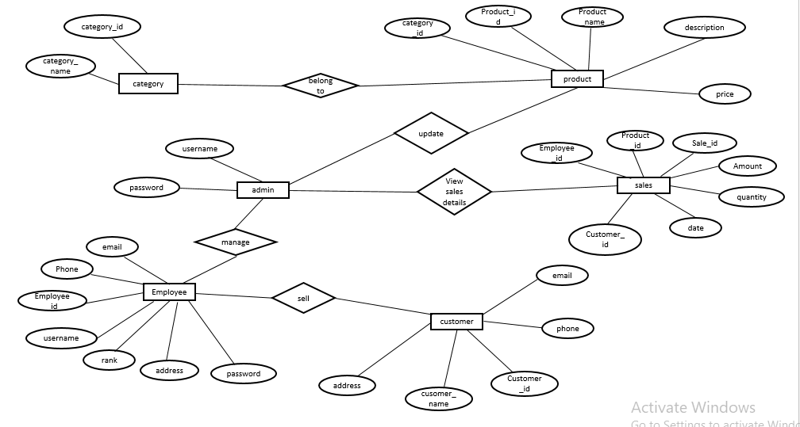
Entity Relationship Diagram

Slide 7
Use Case Diagram

Slide 8
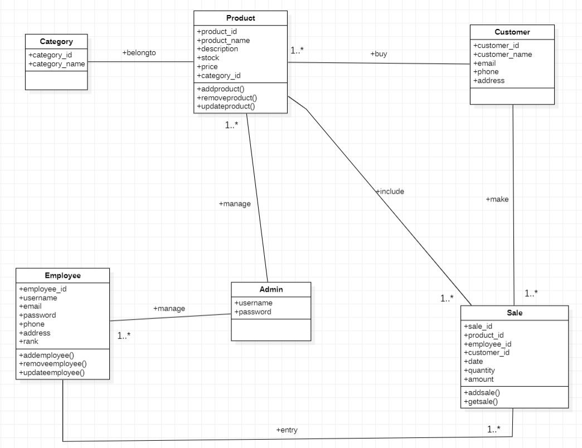
UML Class Diagram

Slide 9
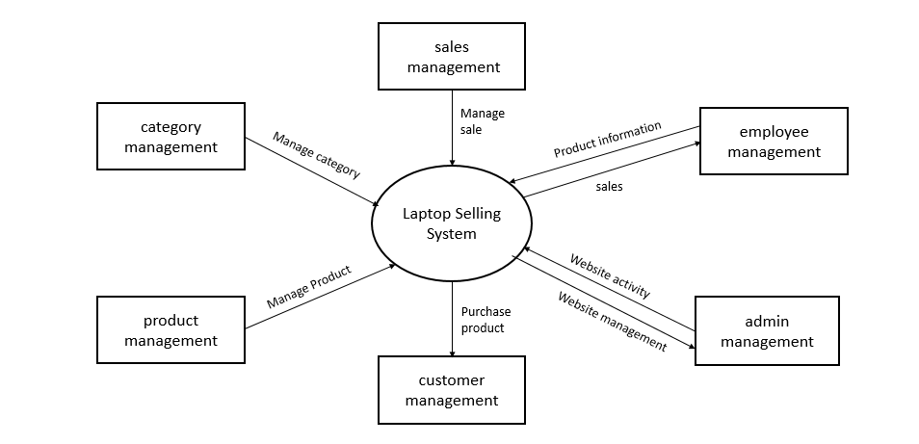
Level 0 Diagram

